Slide 1
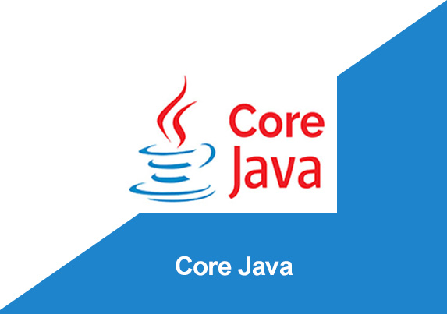
By: Manas Tuwani

Slide 2
POLYMORPHISM
Polymorphism in Java is a concept by which we can perform a single action in different ways. Polymorphism is derived from 2 Greek words: poly and morphs. The word "poly" means many and "morphs" means forms. So, polymorphism means many forms.
There are two types of polymorphism in Java: compile-time polymorphism and runtime polymorphism. We can perform polymorphism in java by method overloading and method overriding.

Slide 3
POLYMORPHISM
Poly means many and morphism means forms. Polymorphism supports:
Method Overloading
Method Overriding.

Slide 4
Method Overloading
Method Overloading
Or
Compile Time Polymorphism
Or
Static Polymorphism
One class contains same method name with different arguments is called method overloading. Compiler will identify the methods based on the arguments.

Slide 5
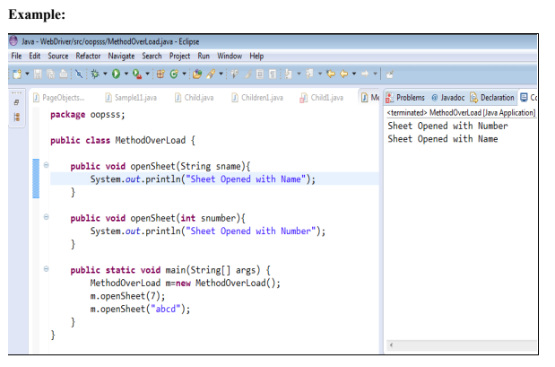

Slide 6
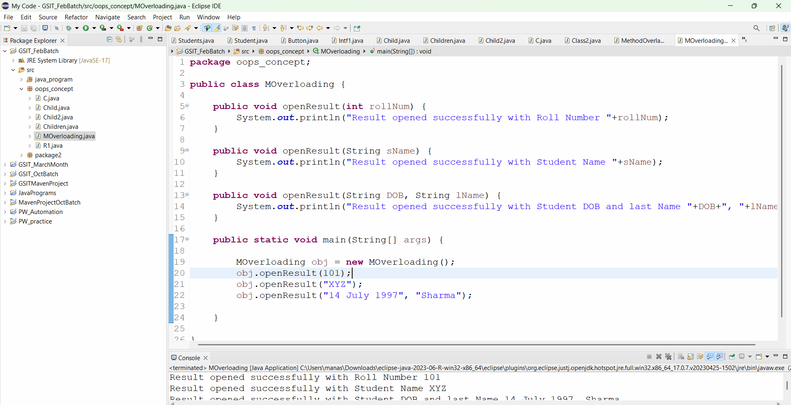

Slide 7
Method Overriding
Method overriding
Or
Run Time Polymorphism
In Method overriding we are creating multiple methods with same name and same arguments.
In this we are creating the same method name with same arguments with inheritance and
sub class method will be overriding super class method.
Note:
Java supports method overloading and method overriding and constructor overloading but does not support constructor overriding.
Method Overriding we can achieve only through Inheritance

Slide 8
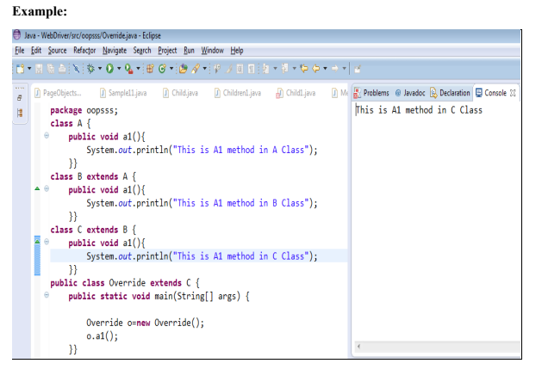

Slide 9
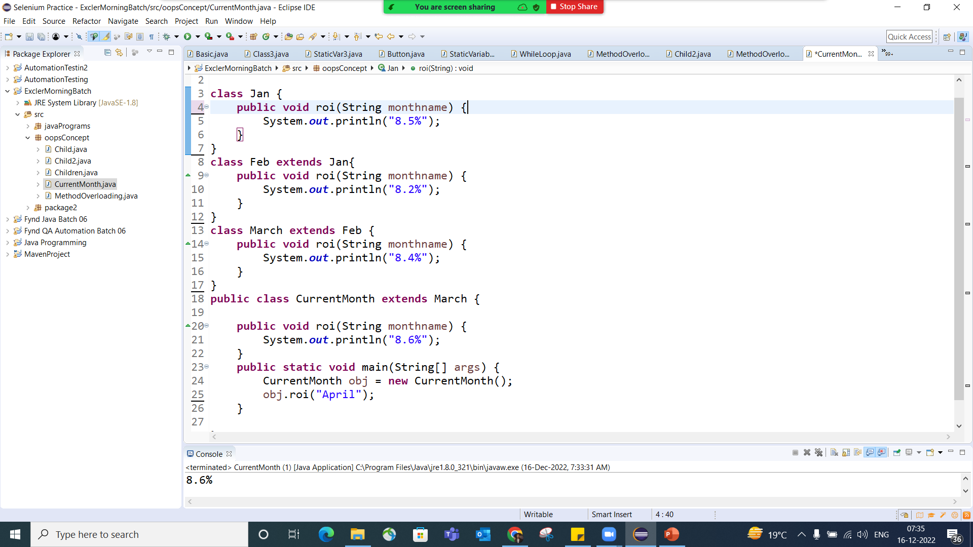

Slide 10

Why And When To Use "Inheritance" and "Polymorphism“ ?
It is useful for Code Reusability: reuse attributes and methods of an existing class when you create a new class.
Extensibility: It allows for easy extension of existing code. You can add new functionality to a class without modifying the existing code, reducing the risk of introducing bugs.

